Slide 1

Phishing Attacks: A Threat to Your Security
Phishing is a type of cyberattack where attackers disguise themselves as legitimate entities to trick users into revealing sensitive information like passwords, credit card details, or personal data.

Slide 2
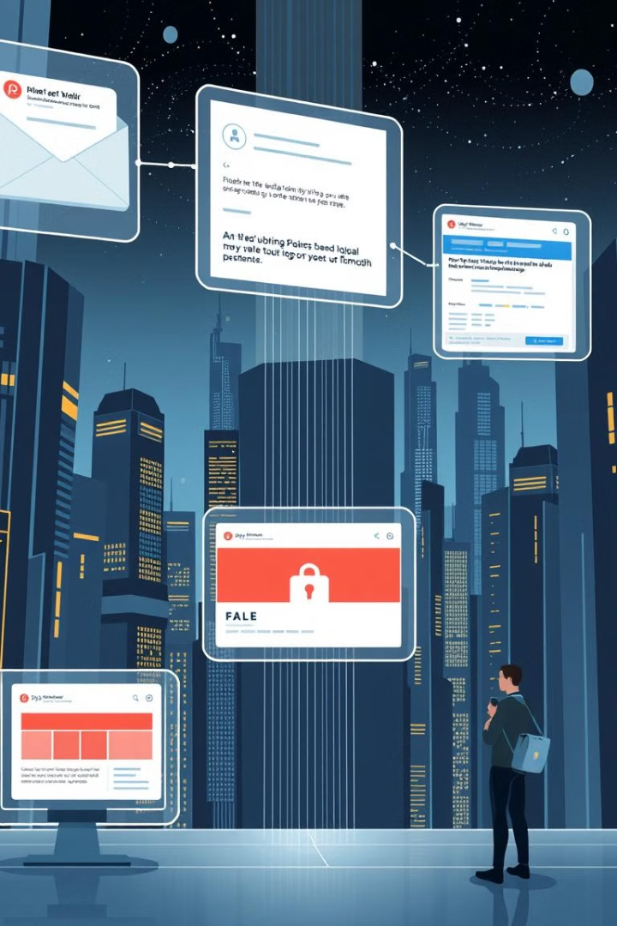
Common Phishing Tactics
1
Email Spoofing
2
Malicious Links
Attackers send emails that appear to come from a trusted source, like a bank or a government agency.
Emails may contain links to fake websites designed to steal your login credentials.
3
Fake Websites
4
Social Engineering
Attackers create websites that look identical to legitimate ones to trick users into entering their personal information.
Attackers use psychological manipulation techniques to trick users into giving away sensitive information.

Slide 3

Recognizing Phishing Emails
Suspicious Sender
Urgent Requests
Suspicious Links
Check the email address carefully. It may contain misspellings or be a generic address like "info@xyz.com" instead of a specific address.
Emails may contain urgent requests for action, such as "Your account is about to be suspended" or "Click here to claim your prize."
Hover over links to see their destination URL before clicking. It may not match the text displayed in the email.

Slide 4
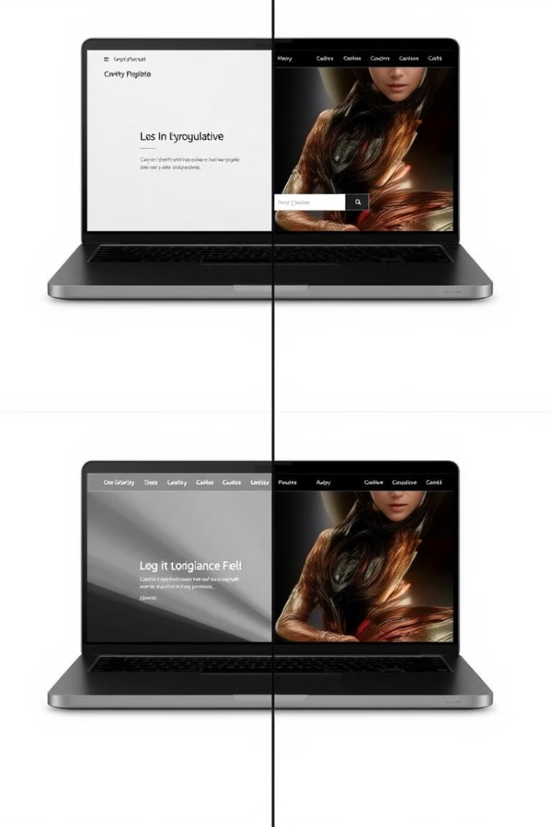
Identifying Phishing Websites
URL Check
Website Design
Verify the website address (URL) carefully. A legitimate URL will be secure (HTTPS), while a fake URL might contain misspellings or inconsistencies.
Look for errors in the website design, such as poor grammar, mismatched fonts, or unprofessional layout. It may be a telltale sign of a fake website.
Website Security
Check for security certificates (HTTPS) and trust badges. Reputable websites will have these security measures in place to ensure your information is safe.

Slide 5
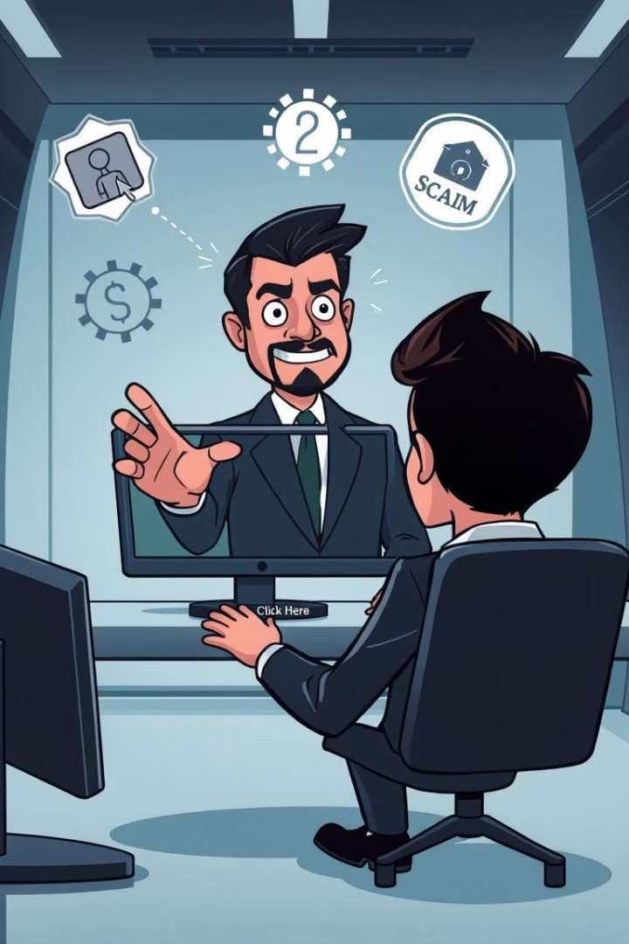
Avoiding Social Engineering Scams
1
Be Skeptical
Don't trust unsolicited calls, emails, or messages, especially if they claim to be from a trusted source.
2
Verify Information
If you receive a suspicious request, contact the organization directly using their official website or phone number to verify its legitimacy.
3
Don't Give Out Information
Never share your personal or financial information with unknown individuals or websites, no matter how convincing their request may seem.

Slide 6






Protecting Yourself from Phishing
Use Strong Passwords
Create unique and strong passwords for all your online accounts.
Enable Multi-Factor Authentication
Add an extra layer of security by enabling multi-factor authentication for your accounts.
Keep Software Updated
Make sure your operating system and software are updated regularly to patch security vulnerabilities.
Be Security-Conscious
Be aware of phishing attempts and practice caution when browsing the internet and opening emails.

Slide 7
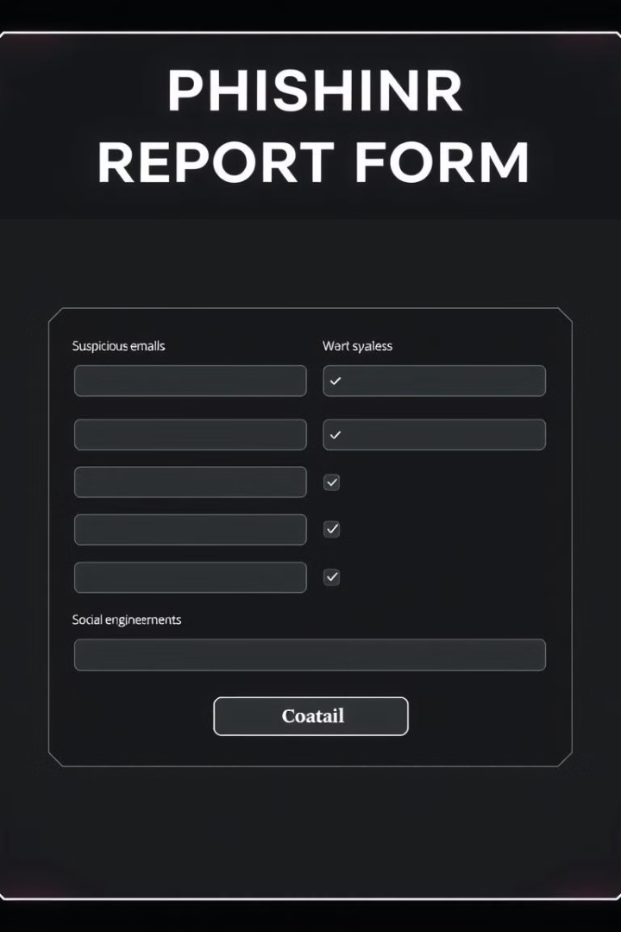


Reporting Phishing Attempts
If you receive a phishing email:
Forward it to your email provider's spam reporting address.
If you encounter a phishing website:
Report it to the website hosting company or the relevant authorities.
If you suspect social engineering:
Report it to the appropriate authorities or your organization's IT department.

Slide 8







Conclusion and Key Takeaways
Stay Informed
Practice Caution
Be Vigilant
Report Suspicious Activity
Stay informed about the latest phishing tactics and scams to stay ahead of attackers.
Be cautious when browsing the internet, opening emails, and clicking on links.
Be vigilant about suspicious requests and always verify the authenticity of information.
Report phishing attempts to the appropriate authorities to help prevent others from falling victim to scams.

